Slide 1



In the chat log, describe what the word “sisterhood” means to you.

Slide 2
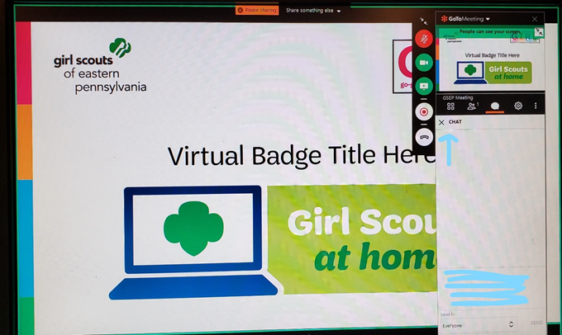
How will this Virtual Troop Meeting work?
•On the right side of your screen, there is a control panel. You should see a microphone, a video camera and a chat bubble.
•When we sing together, you will want to click on your microphone so it is green. Then everyone will be able to hear you.
•If you have a webcam, clicking on it will let everyone else in the meeting see you too.
• The Chat Log looks like a cartoon thought bubble…see it underlined in red? You can type questions or comments into the chat log and everyone will be able to see what you write!

Slide 3


Girl Scout Promise
and Law

Slide 4
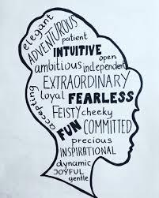
I’m Being Framed- QUALITIES
Continued from DAY 1
Notes:
Use this time to recap from yesterday and ask if there are girls who would like to show their portrait that didn’t get a chance from yesterday.

Slide 5

Girl Scout Basics!
Today we will learn about the SISTERHOOD of Girl Scouts

Slide 6
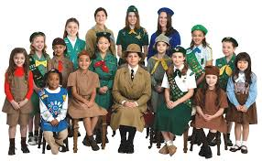
The History of the Girl Scout Law
Notes:
NOTES:
see if anyone can recite the Girl Scout Law ( by memory). Chances are that it won’t be perfect, but they may surprise you. If no one gets it, have one of the girls read it aloud
GO TO NEXT SLIDE (THE LAW)

Slide 7


The LAW itself!
Notes:
NOTES:
Have the girls discuss ways that they can live the Law in their everyday lives—go through each line of the Law.

Slide 8
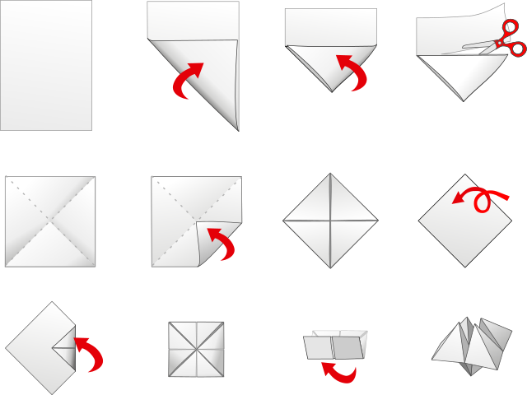
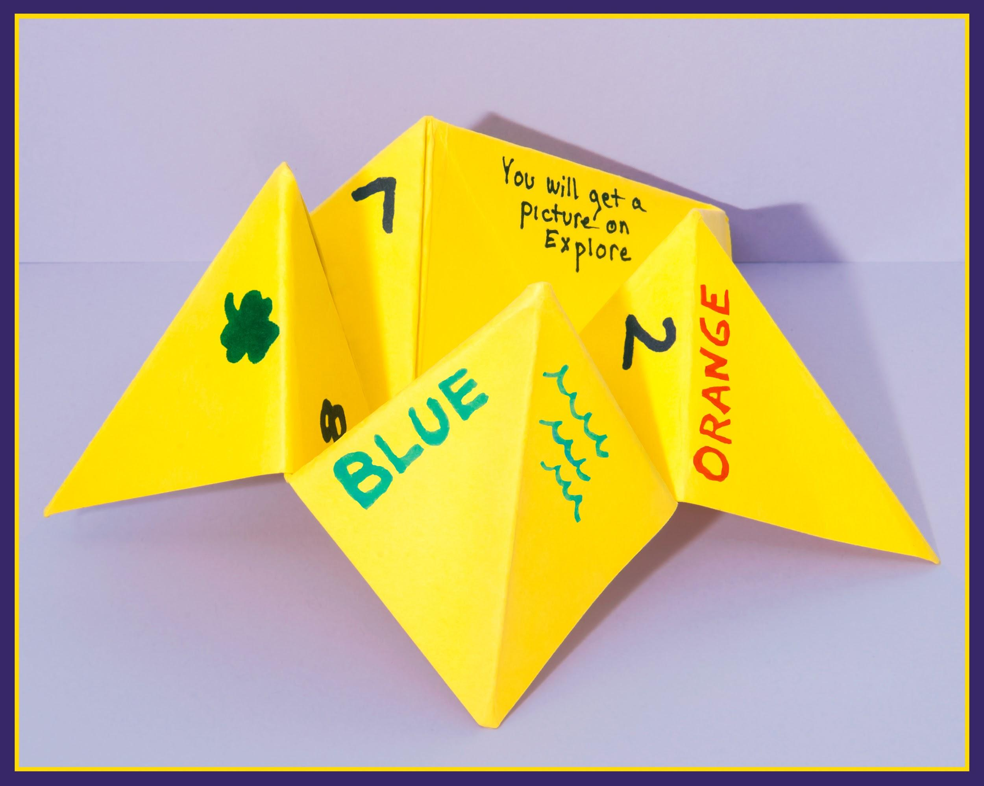
Girl Scout Good Deed Catcher
Living the Girl Scout Promise and Law
HOW TO MAKE DEED CATCHER
I
Notes:
NOTES
Instructions were sent as PRE-WORK in confirmation email· This is incase they didn’t do it ahead of time.
·

Slide 9
Girl Scout Good Deed Catcher
Living the Girl Scout Promise and Law
SUPPLIES NEEDED:
Square piece of paper
(you may need to cut paper to square)
Pencil or Marker
INSTRUCTIONS:
Write the Girl Scout Promise on the outside four squares.
Then write the Law on the inside either triangles.
Under each part of the Law, write an action that represents that part of the Law.
Notes:
NOTES
· Remind the girls of the exercise they did in Activity One.
Instructions were sent as PRE-WORk in confirmation email·
Using the square pieces of paper, have the girls make Good Deed Catcher (Cootie Catchers)
· They should write the Girl Scout Promise on the outside four squares.
· They write the Law on the inside either triangles.
· Under each part of the Law, write an action that represents that part of the Law.
· Girls can then take turns with other girls “catching good deeds” that represent the meaning of the Girl Scout Promise and Law.

Slide 10
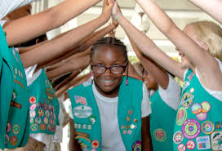
HERstory - Tying it Together
PREPARING for DAY 3
We will explore famous women in history.
We’ll learn about ordinary women who did extraordinary things.
We’ll also learn about women alive today who are making a difference
Please come prepared tomorrow with 2 women in History you’ve researched and someone in your family you consider EXTRA- ordinary
We will discuss as a group.
Notes:
Ask the girls which of the women made the most impact (allow the girls to express their opinion – remember, all answers are allowed).
Ask the girls if they have a woman in their own family (past or present) they consider extra- ordinary. Let them express why/how.

